Slide 1

HD Jones System Analysis
Wienerware Entertainment

Slide 2
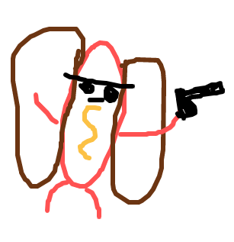
David: Story Description
HotDog Jones: THE VIDEO GAME
Revenge story taking place after the death of HotDog Jones’ wife
HotDog Jones will go on a journey to find himself and the man who killed his wife
HotDog Jones seeks to change the fundamental laws of the universe
How will his ambitions change the player?
Journey through the city of Foxborough, MA
*Concept Art

Slide 3
David: Storyboards
HotDog Jones: THE VIDEO GAME opens with a black screen and text introducing the background of the game
Dialogue: “While enjoying lunch with your wife Gisele, she suddenly dies after trauma to the head caused by a blunt object”
While enjoying lunch with…

Slide 4
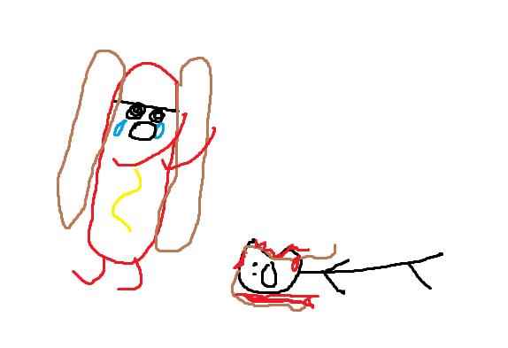
David: Storyboards
HotDog Jones mourns the Death of his wife, and then (the player) immediately proceeds to wreak havoc on the other patrons of the establishment knowing they are in on it
Action: Shooting Enemies
Note: Football shaped dent in wife’s head

Slide 5
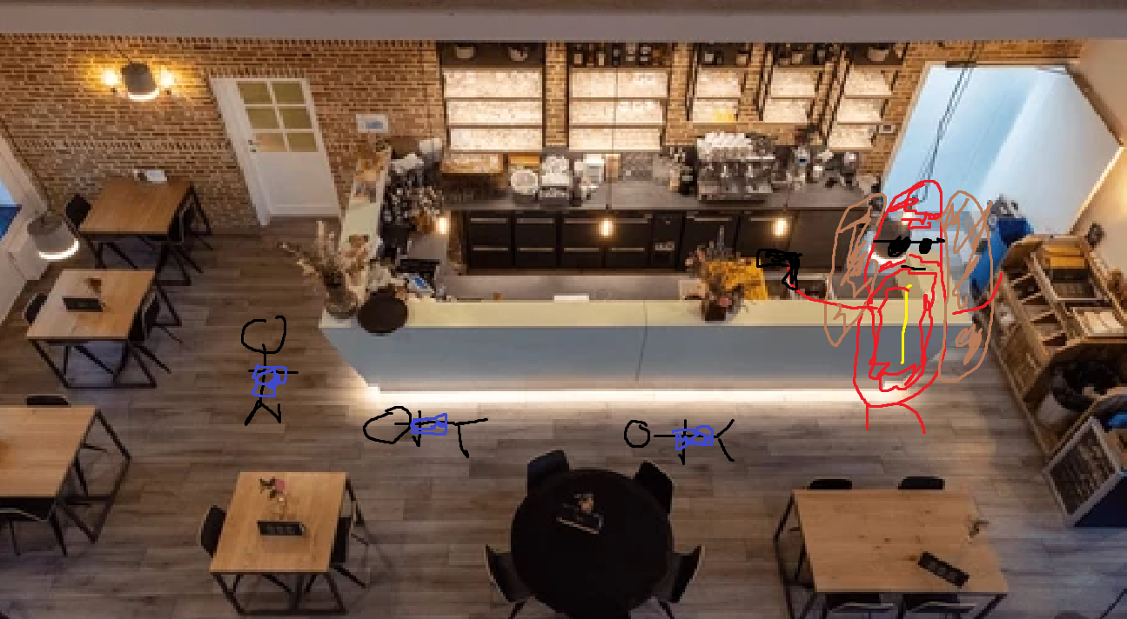
David: Storyboards
HotDog Jones is noticeably larger after clearing the room of enemies through his hotdog powers. Notices all of the patrons were wearing blue jerseys
Hotdog Jones decides to make his to the origin of these jerseys
Note: Checkpoint after he leaves the restaurant

Slide 6
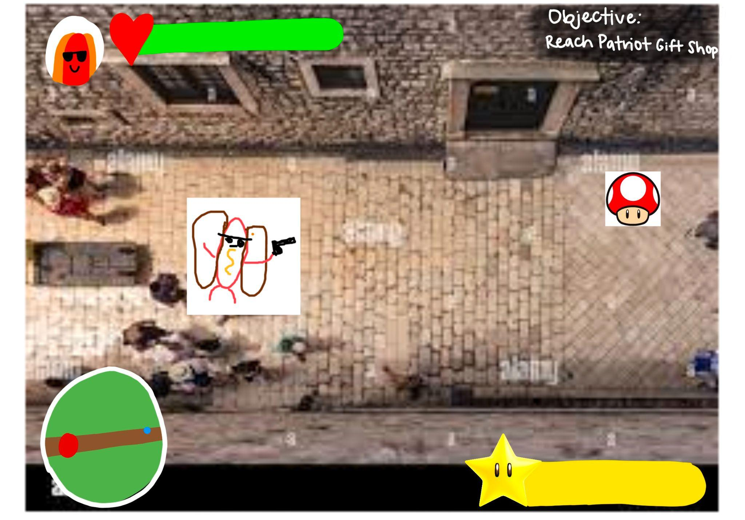
David: Storyboards
HotDog Jones makes his way through the alley to make his way to the shop. He continues to increase in size.
Notes: The alley is the first occurrence of powerups in the game. Checkpoint after he leaves the alley
Action: Shooting enemies and collecting power ups

Slide 7
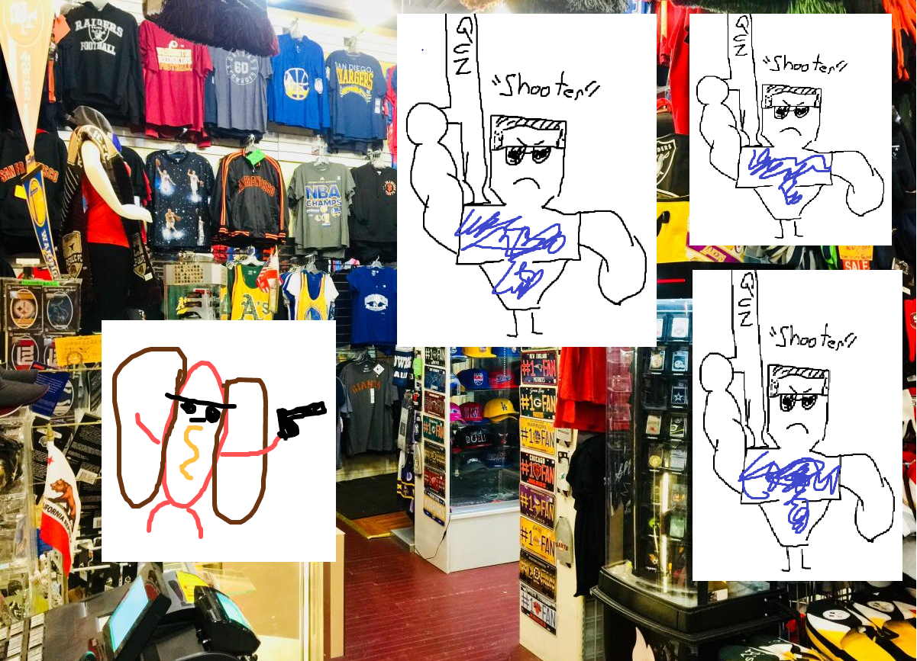
David: Storyboards
HotDog Jones enters the shop finding a larger amount of enemies and new enemies. But he is not satisfied with his hunt
Notes: The shop is the first occurrence of the shooter enemy. Checkpoint after he leaves the shop
Action: Shooting enemies, collecting power ups, dodging projectiles

Slide 8
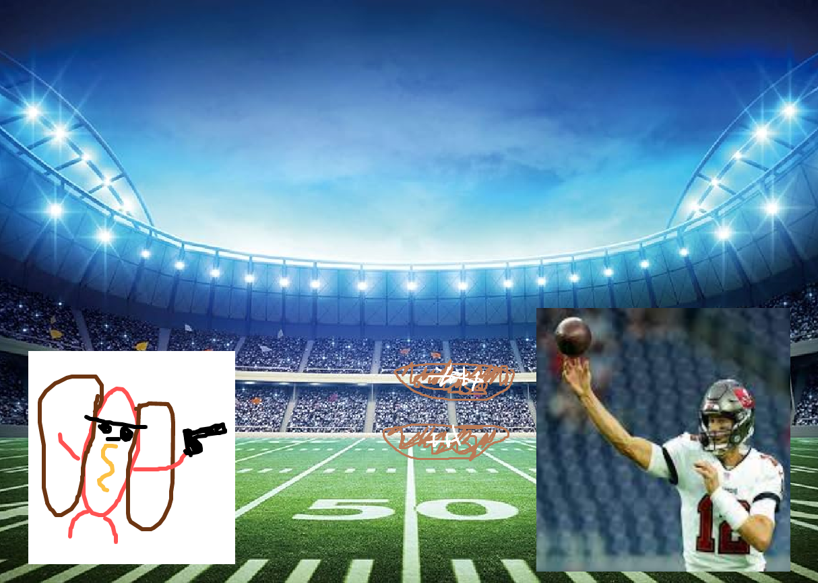
David: Storyboards
HotDog Jones enters the stadium where he finds the man who killed his wife. The have an all out duel
Notes: This is the final boss of the game. Similar to the shoot enemy but anything that can be scaled up is.
Action: Shooting enemies dodging projectiles

Slide 9
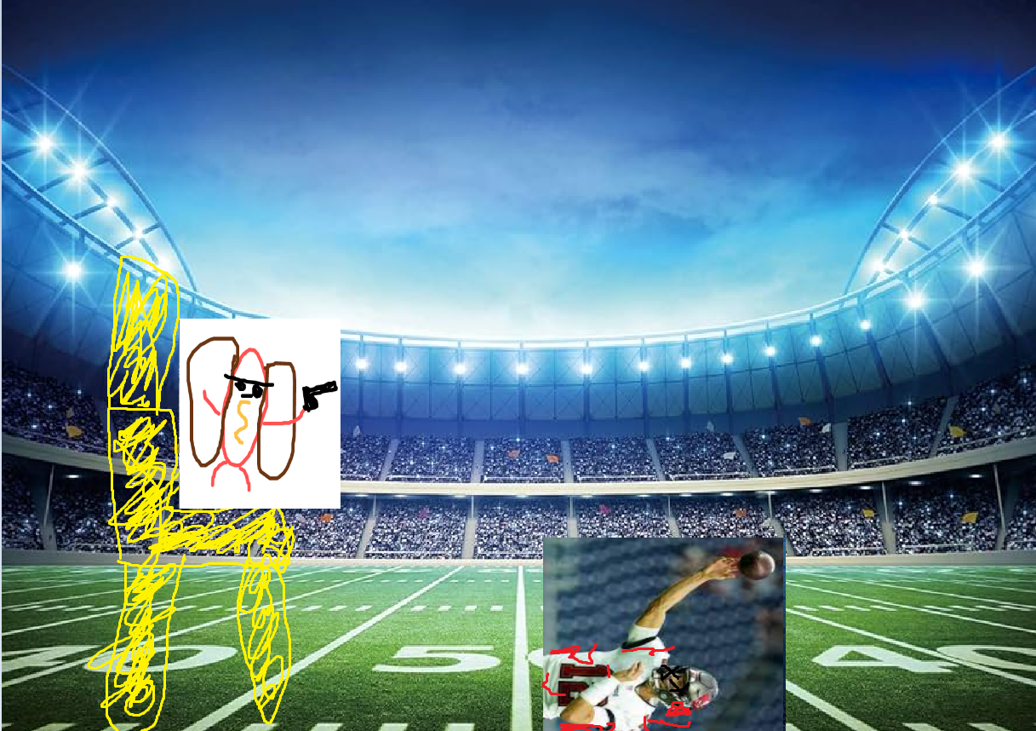
David: Storyboards
After winning his duel, HotDog Jones sits upon his golden throne as the new god king of this world
Action: Game Over

Slide 10
David: Storyboards
HotDog Jones: THE VIDEO GAME fades to black and a message appears upon the screen
Dialogue: “Perceive Thyself”
Perceive Thyself…

Slide 11
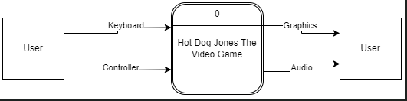
Introduction: Context Diagram

Slide 12
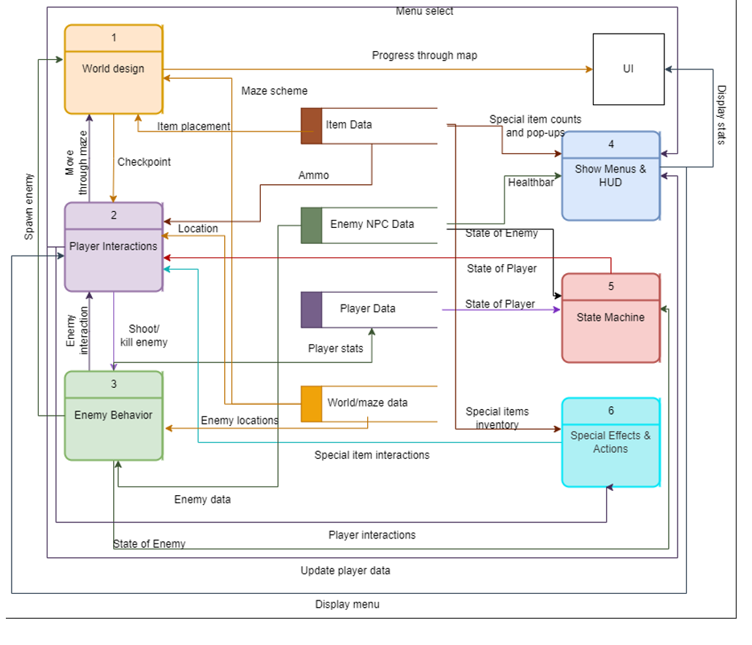
Level 0 Diagram
Matthew
K
David
Rebecca & Jon
Andrew
Meghan

Slide 13
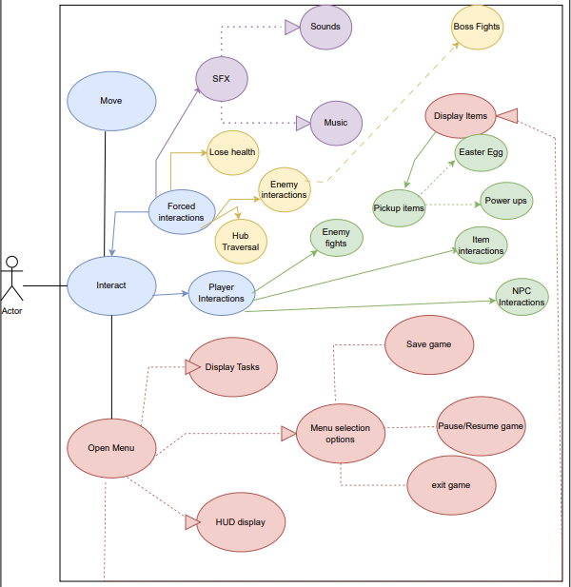
Global Use Case
This is our global use case and how we interact with integral parts of our game
Notes:
Jon start menu
Back to Matthew for beginning of game
Back to Meghan and Jon (sound effects, player with special items interactions and changes)
David for enemy spawns
Back to K for player interactions/movement
Go to andrew for state of player and enemies
Go to Rebecca for Displayment of interface

Slide 14




Jon: Menu (pause/main)
Main: simple play quit options. Can access settings
Pause: Allows the player to access the settings, to quit and to go back to the main menu.
Play
Quit

Slide 15

Jon: Menu Design cont.
(Game over)
You’ve been grilled…
Try again
Quit
Game over: displays game over options such as quit and play again, and main menu.

Slide 16
Jon: Help Page/Settings
- Includes a well written description of the actions that take place throughout the game, controls and anything that the player might find helpful.
- Can be accessed on any menu except for the game over menu.
- Settings will be simple UI changes such as sound/music volume, brightness.
Help!

Slide 17
Matthew - World Design and MVP
Responsibilities:
MVP
Making sure everything works
Smooth transitions between scenes
World Design
What are our levels going to look like?
Priorities:
MVP: Highest
World Design: Highest
Complexity:
Medium/High

Slide 18
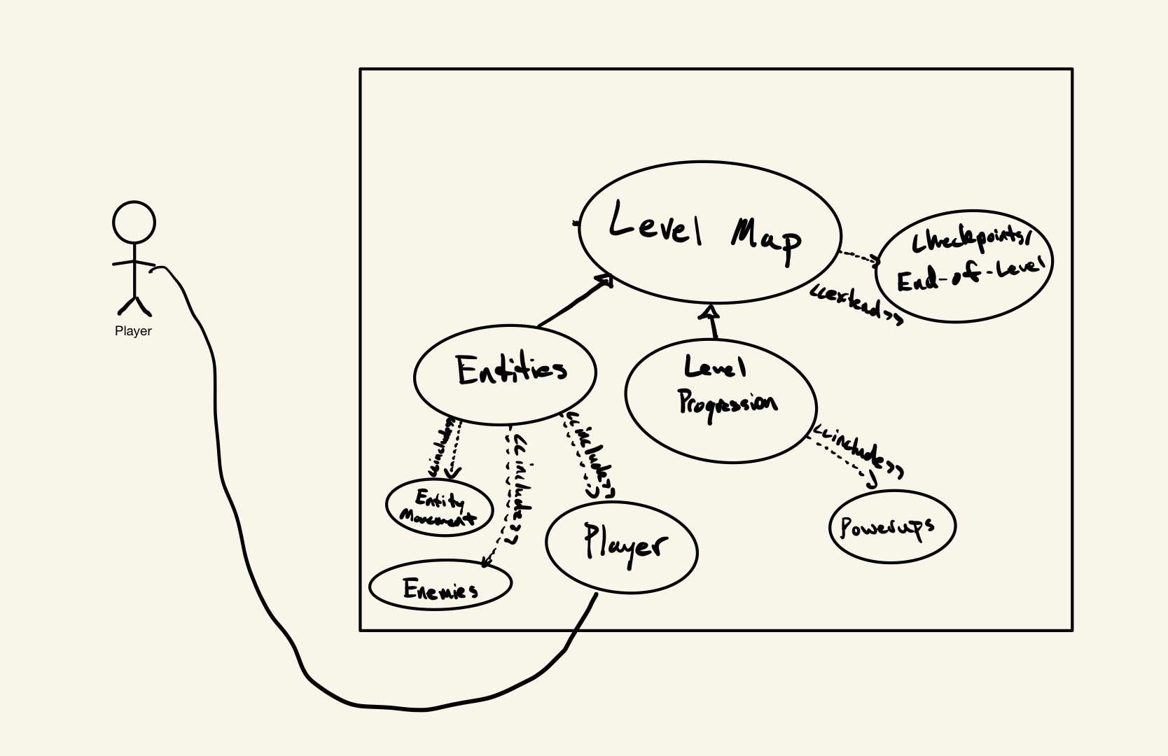
World Design Use Case
Matthew

Slide 19
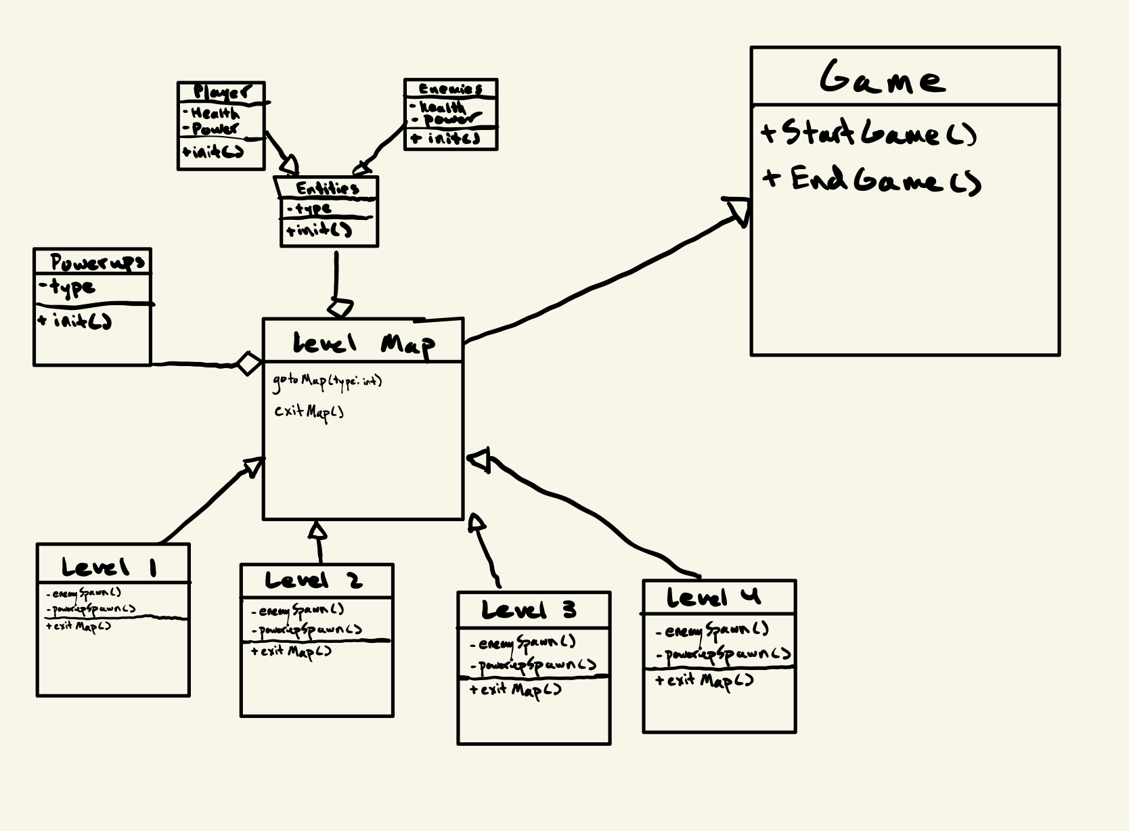
World Design Class Diagram
Matthew

Slide 20
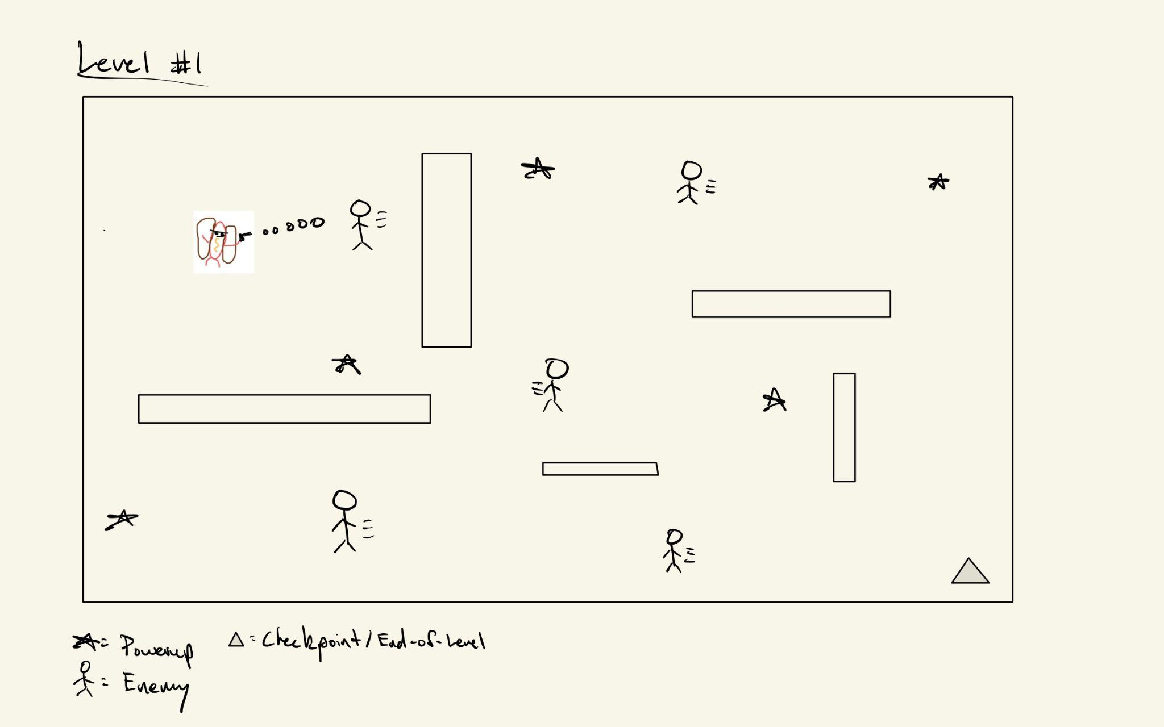
Level 1
Numerous “obstacles” around the map
Enemies moving/being spawned in various locations
Powerups
Checkpoints/End of Level
Matthew

Slide 21
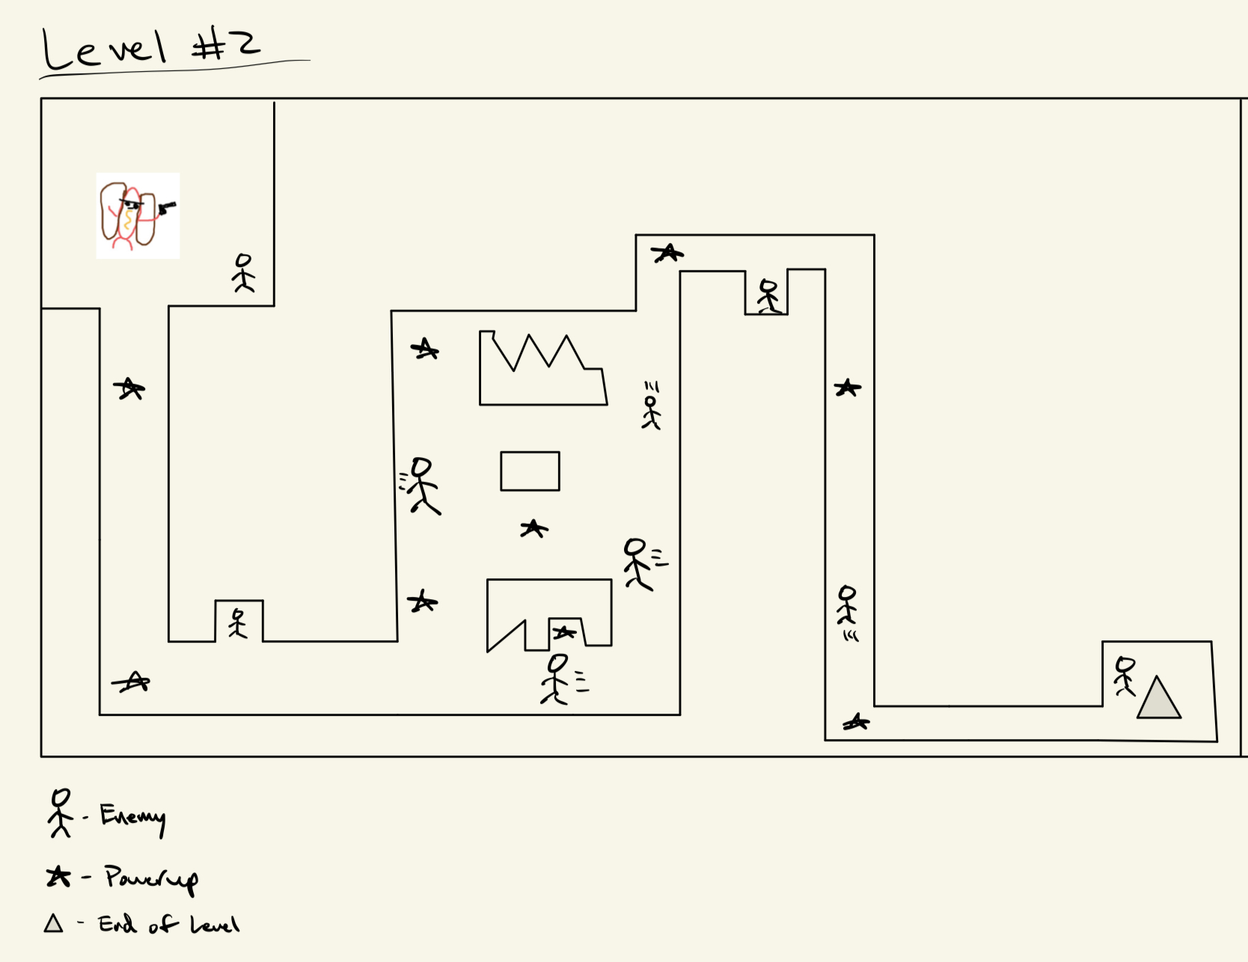
Level 2
Limited space for movement
Abstract obstacles
Matthew

Slide 22
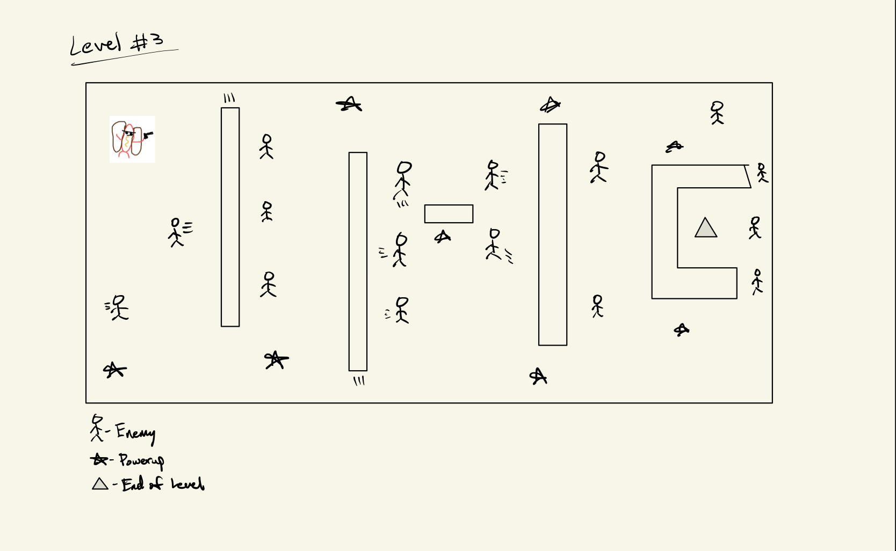
Level 3
Moving obstacles
Stronger enemies
Matthew

Slide 23
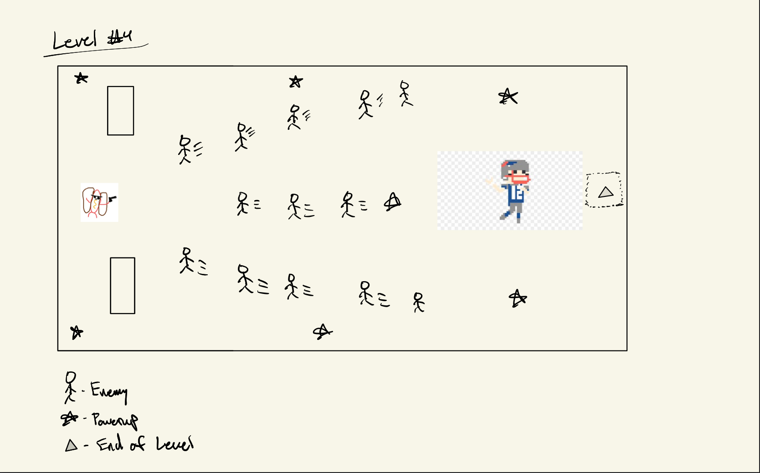
Level 4
Defeating Tom Brady
Most difficult level
Matthew

Slide 24
HUD
Health bar in top left corner
Mini map in bottom left corner
Mission statement in top right corner
Power up display in bottom right corner

Slide 25
HUD Feature
Feature Breakdown
Mini map
Health bar
Power up display
Mission display
Feature Priority
Important for usability of the game
Game could function without
2/3
Overall Role
To communicate player stats to the player to enhance the games playability
Complexity
Not as complex as other features
Builds on top of teammates features to provide a UI
Rebecca

Slide 26
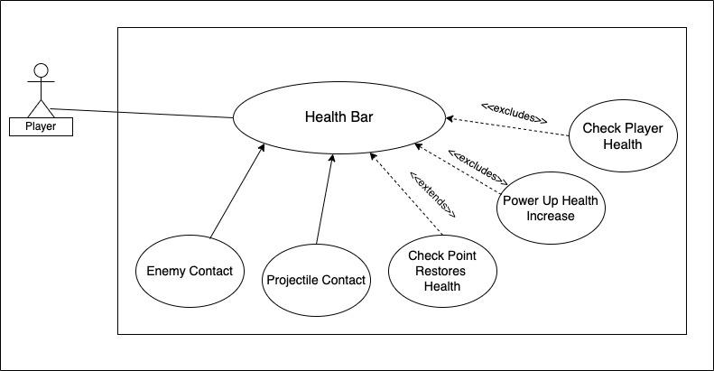
HUD Use Case
When player contacts an enemy, player health will decrease
When player contacts a projectile, player health will decrease
Exceptions
Player health = 0, player dies
Player reaches checkpoint, player’s health restores to full
Player picks up a power up, health increases by 5 points
Rebecca

Slide 27
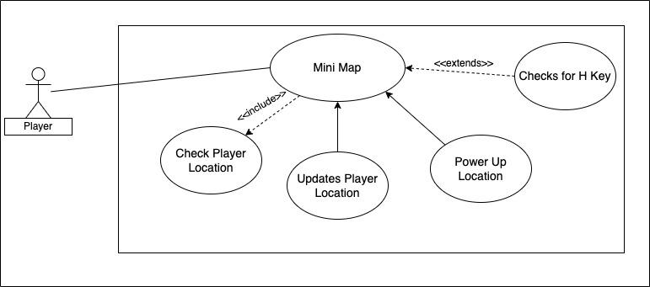
HUD Use Case #2
Function checks for player location
Icon on map correlates to player movement, updates
Power ups will appear on map when generated
Exceptions
Player presses ‘h’ key
Rebecca

Slide 28
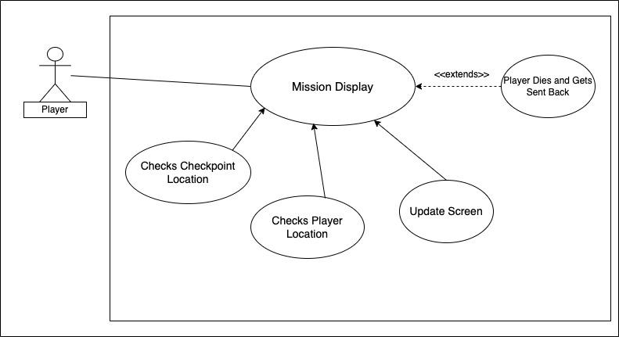
HUD Use Case #3
Variable for checkpoint location
Function for player location
Screen is updated to display next mission
Exceptions
Player dies and gets sent back to latest checkpoint, update mission statement
Rebecca

Slide 29
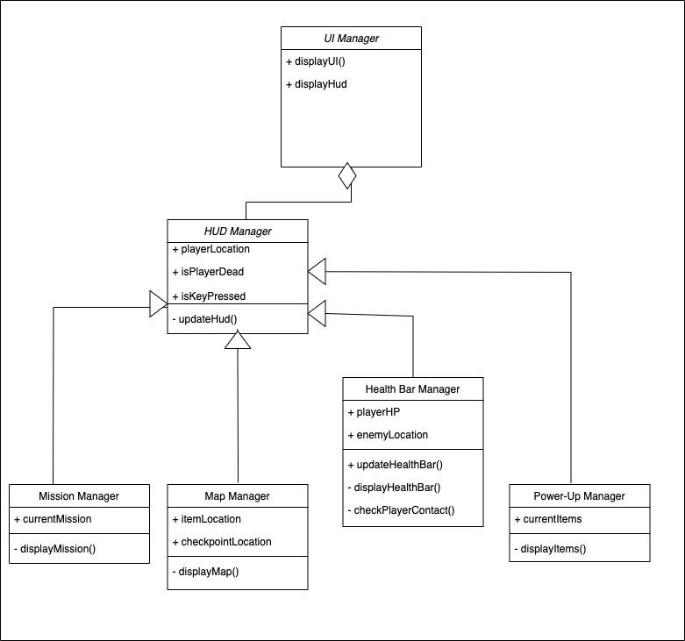
HUD Class Diagram
Rebecca

Slide 30
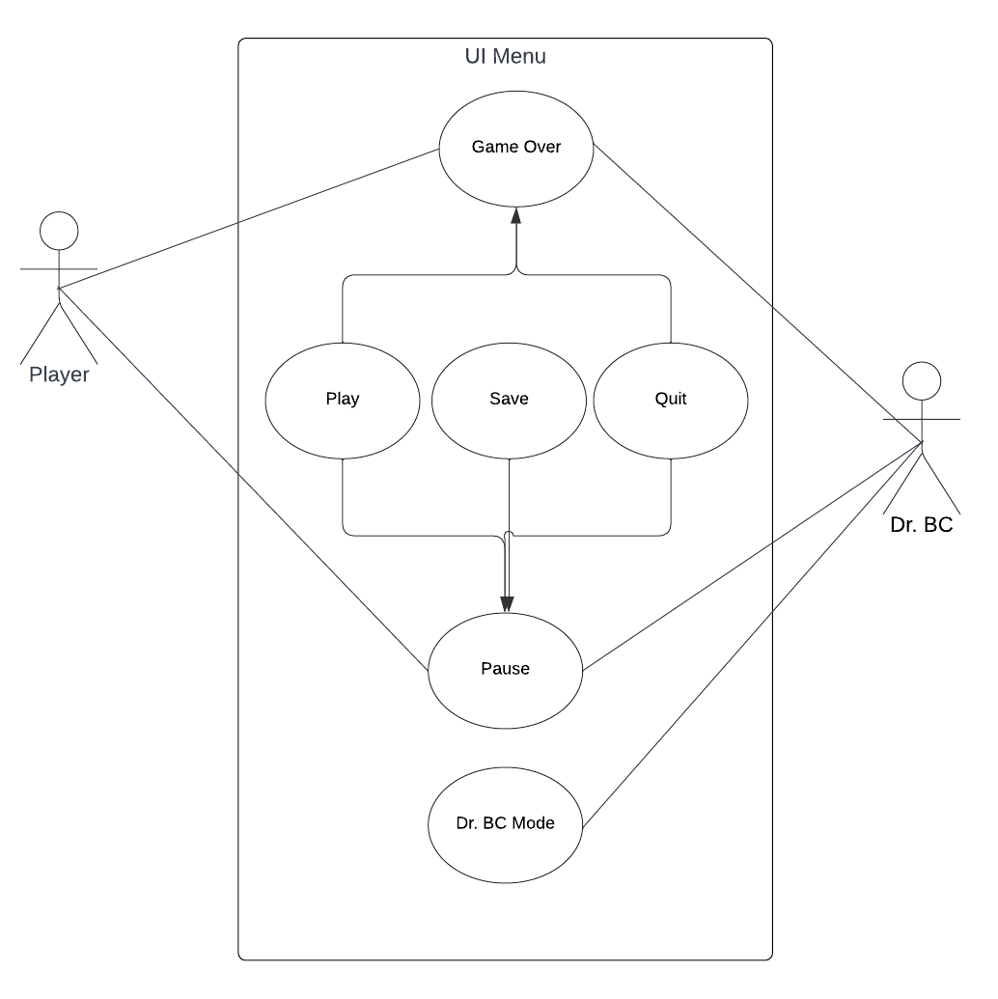
Jon: UI Menus
Actors: Player and Dr. BC
Game over and pause menus: Both have the ability to play and quit.
Pause happens when you pause, game over happens when you die.
Play has quit, resume and save game while game over has play again and restart.

Slide 31
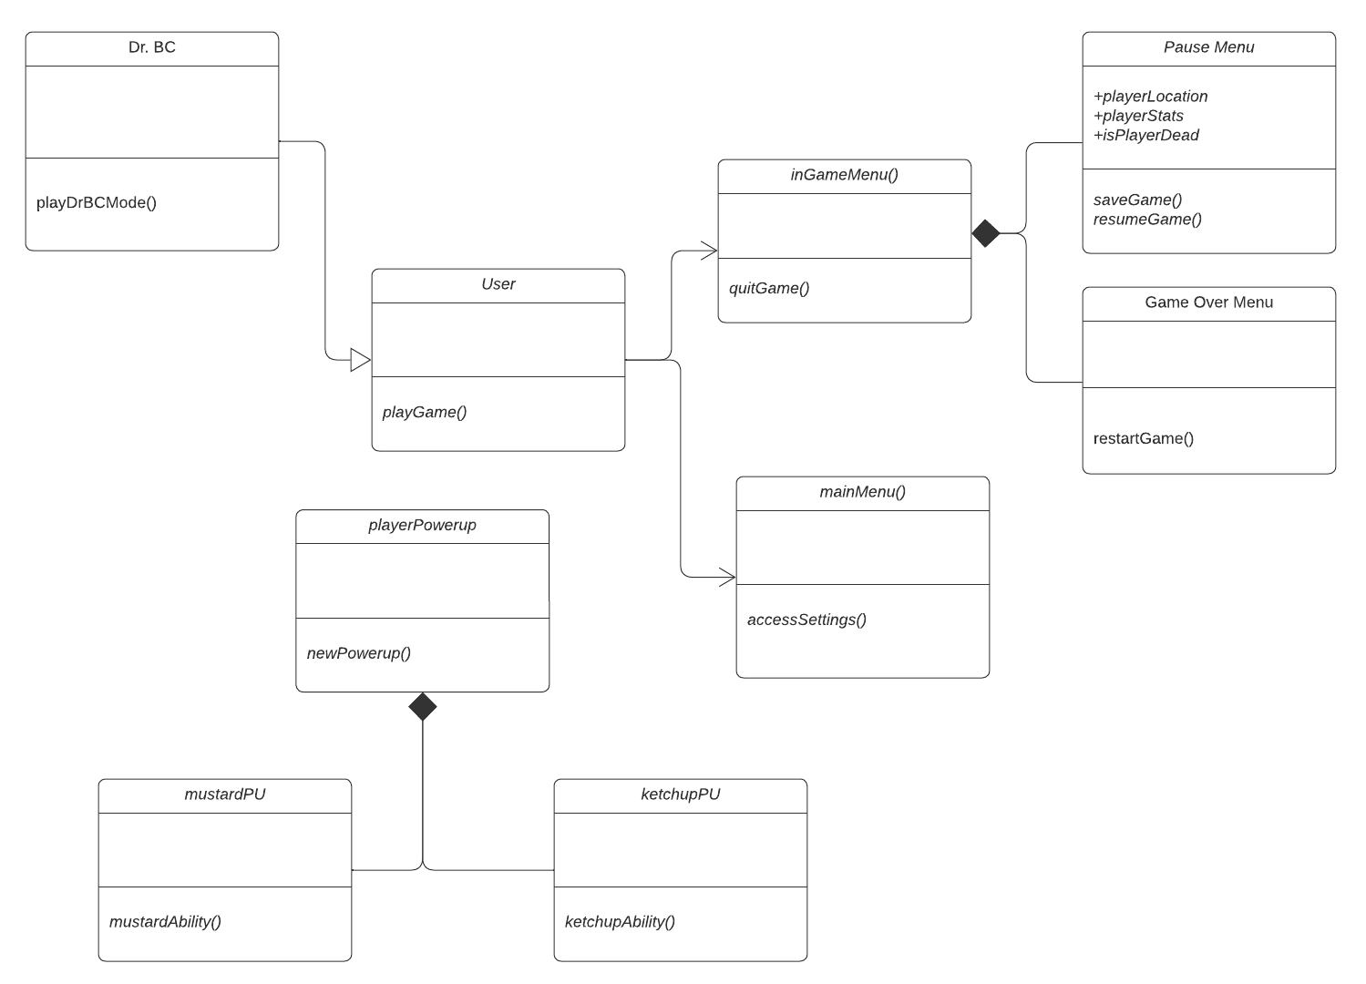
Jon: UI menus & enemy
User: main person who’s playing with subclass Dr. BC
Separate enemy class childEnemy, who steals powerups.
The displayMenu class has a collective of the pause menu and game over menu.

Slide 32
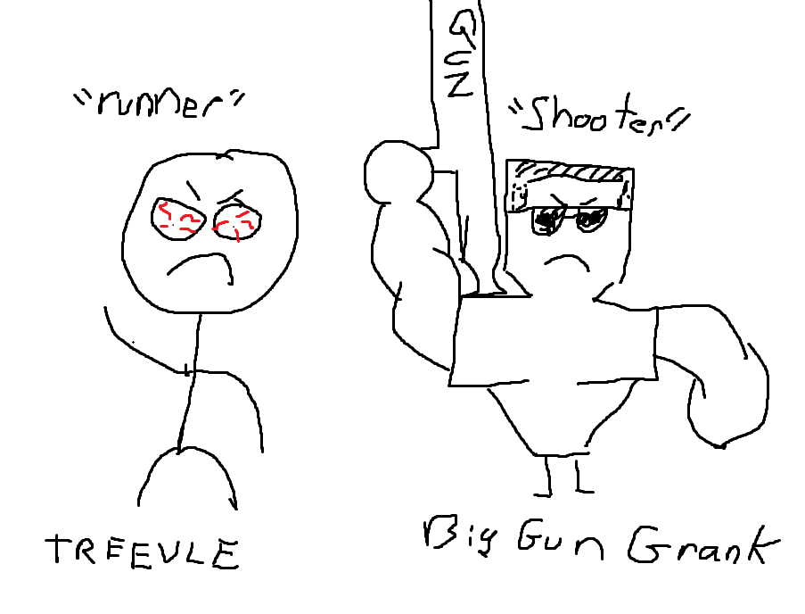
David: Enemies and Enemy Interaction
*Concept Art
Health
Attacks
Enemy Death
Spawns
Enemy Type
Priority 1
Complexity
Adapt and Enhance Enemy(s)
Estimation of complexity is moderate

Slide 33
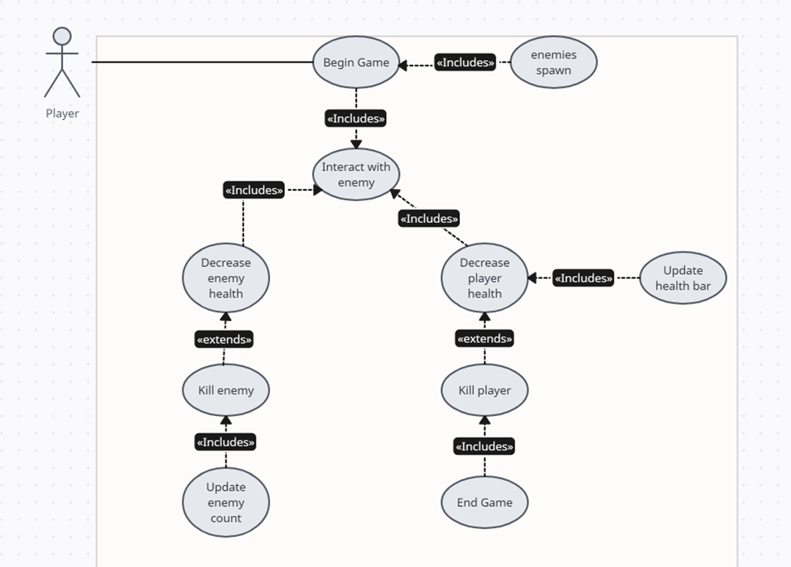
Enemy Use Case Diagram
Enemies spawn upon level creation
The Enemies and Players can attack each other leading to lost health
Exceptions
Upon enemy or player death
David

Slide 34
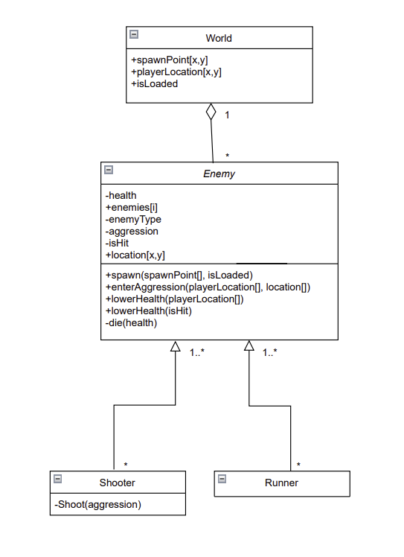
Enemy Class Diagram
David

Slide 35






K: Checkpoints & Item Actions
Checkpoint actions
Checkpoints = “levels”
Get player stats to determine next moves in the game
Builds on enemies, power-ups (special items), world design, and state machine
Use case (2x)
Checkpoint actions: Priority 1
Shoot hot dogs: Priority 2
Complexity:
Player movement - Low
Player-world interaction - Med
Player-item interaction - High
Shoot hot dogs

Slide 36
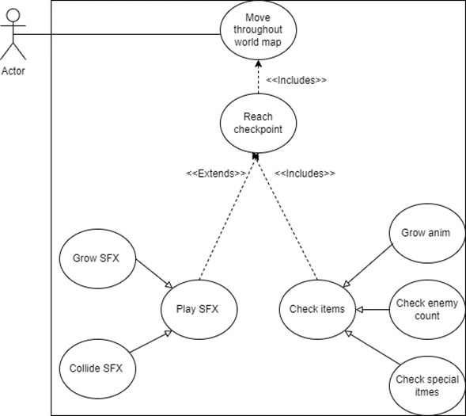
K: Checkpoints & Item Actions
Use Case: C02A.1
Arrows keys to move
Reach checkpoint and perform a series of checks:
Enemy count?
Power-ups/easter eggs?
Health?
FinalBoss checkpoint?
If favorable checks, player grows and moves to next
Exceptions:
Player dies, respawn
Arrow keys or space bar (shoot) not pressed

Slide 37
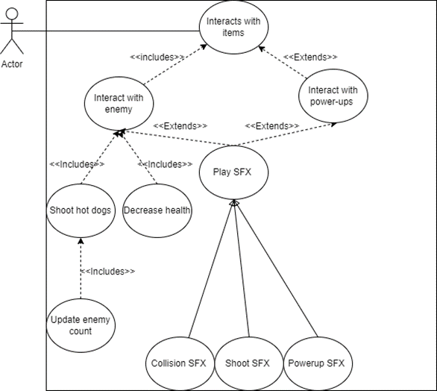
K: Checkpoints & Item Actions
Use Case: C02A.2
As player moves throughout world, hot dogs are fired as ammo at enemies
Enemies die if shot by three hot dogs OR player loses health if he collides with the enemies (David’s use case)
Exceptions:
Decrease health if collision w/ enemy
Enemy count reset if respawn
Space bar not pressed

Slide 38
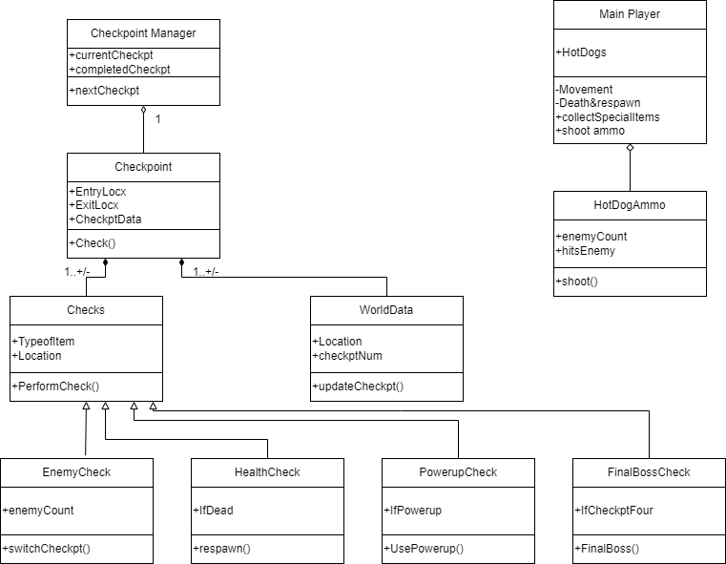

K: Checkpoints & Item Actions

Slide 39
Animations and State Machine: Andrew Bonilla
Animations of the main character and the enemies in each level will allow for more intriguing gameplay
The main character will get new animations when they pick up a powerup
There will be animations for player movement, taking damage, and death same for enemies
What is a State Machine?
Programming pattern used to manage the behavior of game objects. It allows for the organization of logic within the game into different states, where each state represents a specific behavior or set of actions that an object can perform.
Priority: High
Control and Organization using the state machine is important.
The state machine will allow for easier debugging and troubleshooting
Transitions between different states and animations can enhance gameplay
Enhance quality, efficiency, and flexibility
Complexity: Moderate
Management of the hierarchical states can add complexity, e.g. may have high-level states like “moving”, “attacking”, and “idle” each containing a sub-state for specific actions or animations
Big focus on fluidity of animations and transitions to create a fun, good looking game
Ensuring interactions and dependencies are handled within the logic of the state machine

Slide 40
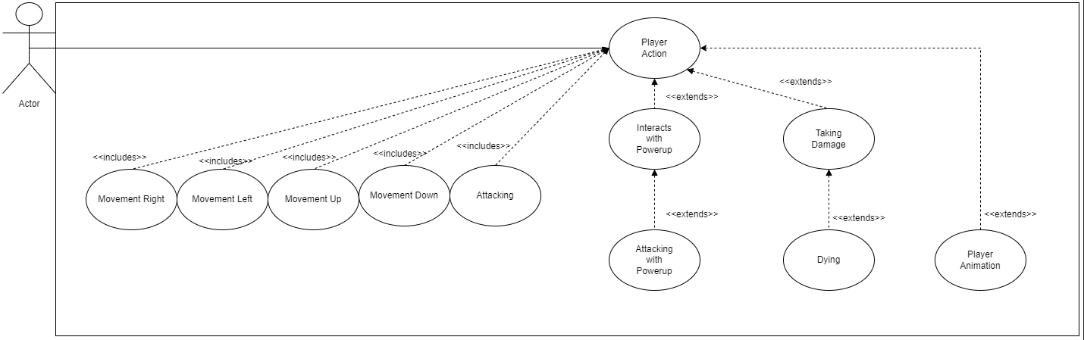
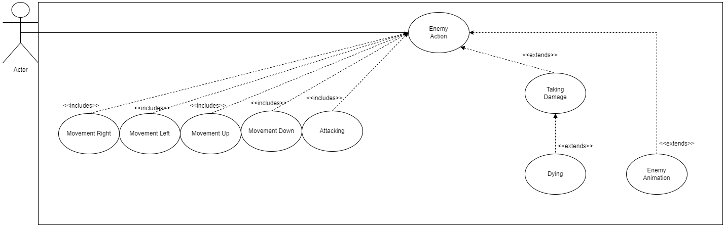
Use Case Diagrams - Andrew Bonilla

Slide 41
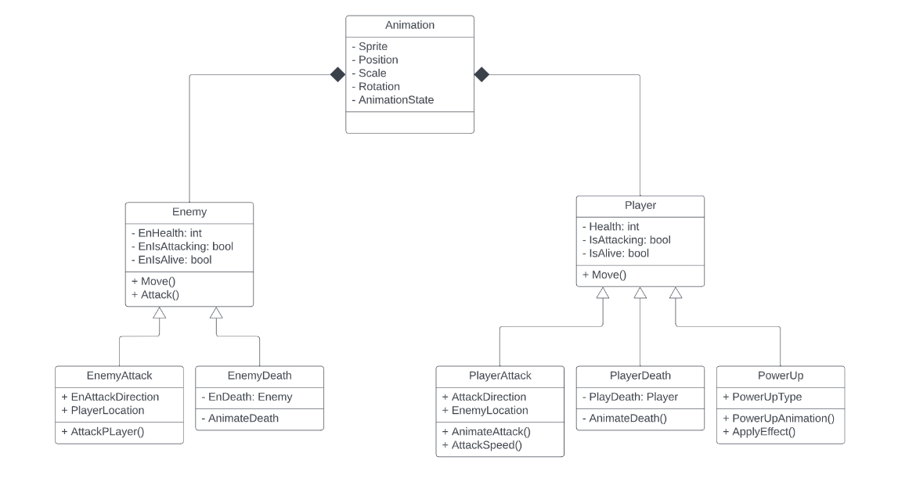
Class Diagram: Andrew Bonilla

Slide 42
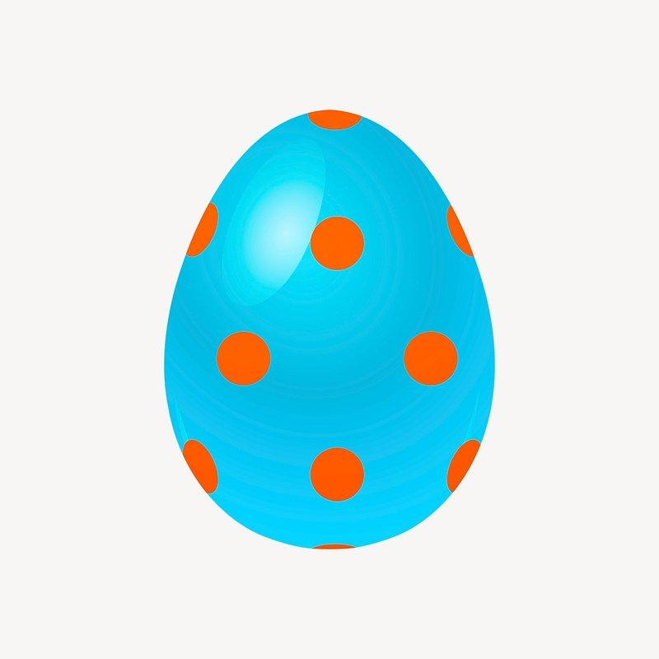

Special effects and Actions
Music in the background
Sounds when certain actions are performed or things happen
Easter Egg storyline opportunity
Meghan

Slide 43
Sound Features
Sound Feature Breakdown
Shooting sounds
Killing enemy sounds
Button sounds
Obtaining items sound
Music changes for different levels or areas of the game
Music Priority
Important for experience
Game could function without
3/3
Overall Role of Sounds
To enhance user interaction happiness with sounds for game to be more interesting.
Complexity
Not nearly as complex as other features
Builds on top of teammate’ss features as there are only
Meghan

Slide 44
Easter Egg Features
Easter Egg Breakdown
Item that appears once certain criteria are met
Obtainable within the HUB world
Adds physical change to Hot Dog Jones
Easter Egg Priority
Important for a deeper experience
Game could function without
3/3
Overall Role of the Easter Egg
To enhance user experience happiness with a “side quest” for the game to be more interesting.
Complexity
Somewhat complex as other features
Builds on top of teammate’s features as it is dependant on some level requirements to appear as wel
Meghan

Slide 45
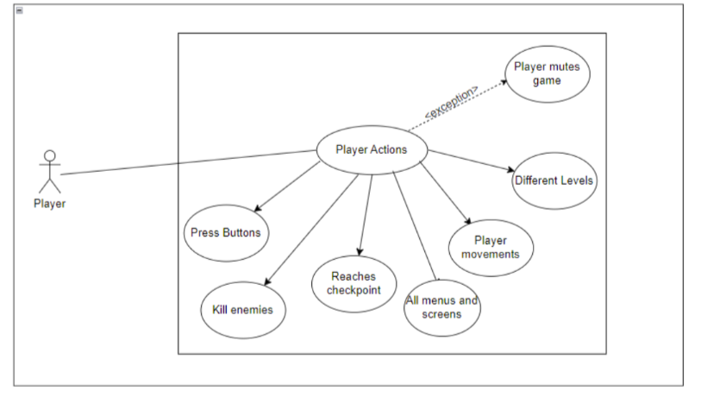
Auditory Use Case
When a player contacts, kills, or interacts with inanimate objects, kills an enemy, or presses some menu button a sound will play.
Whena player goes to new area in the HUB world, the background music may change
Exceptions
Player mutes game
Meghan

Slide 46
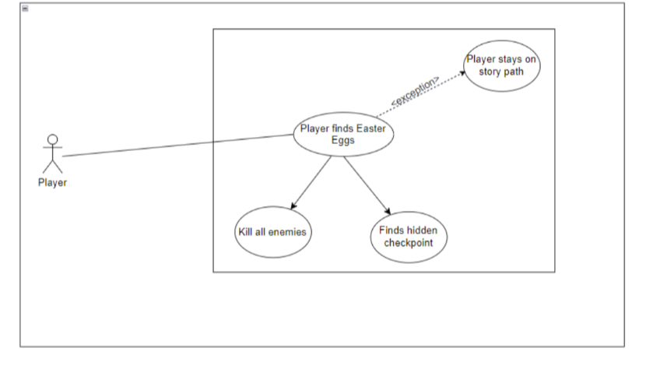
Easter Egg Use Case
When a player completes certain requirements, a path to an easter egg will appear.
This will change a physical feature of how Hot Dog Jones appears
Exceptions
Player misses steps to completing easter egg tasks
Player skips part of game
Meghan

Slide 47
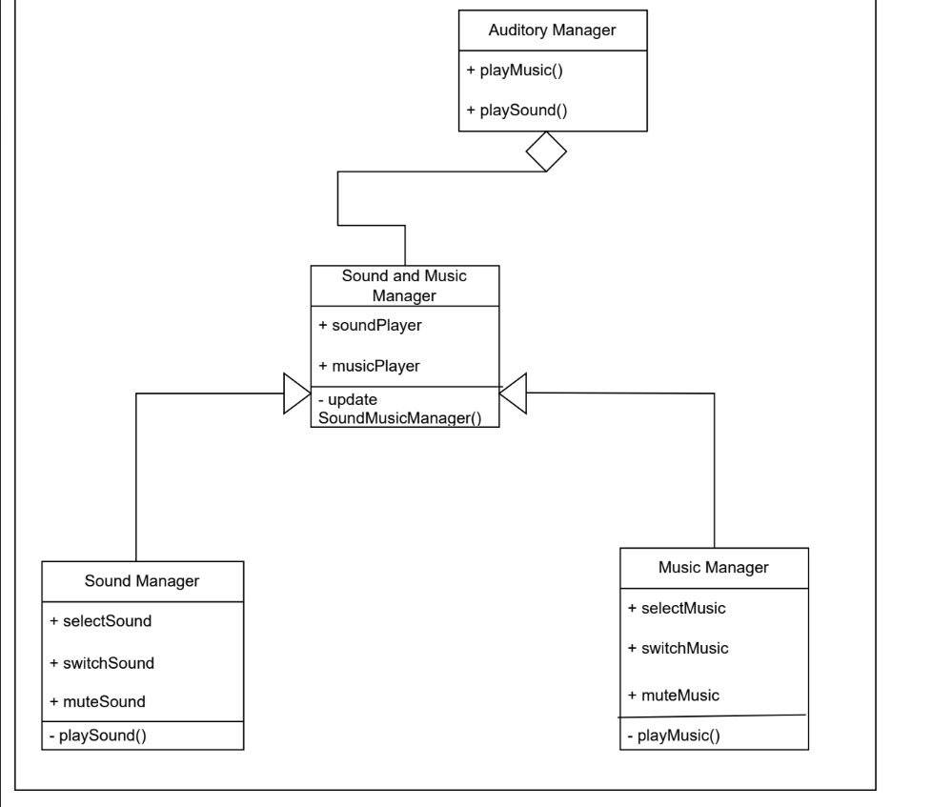
Sound & Music Class Diagram
Meghan

Slide 48
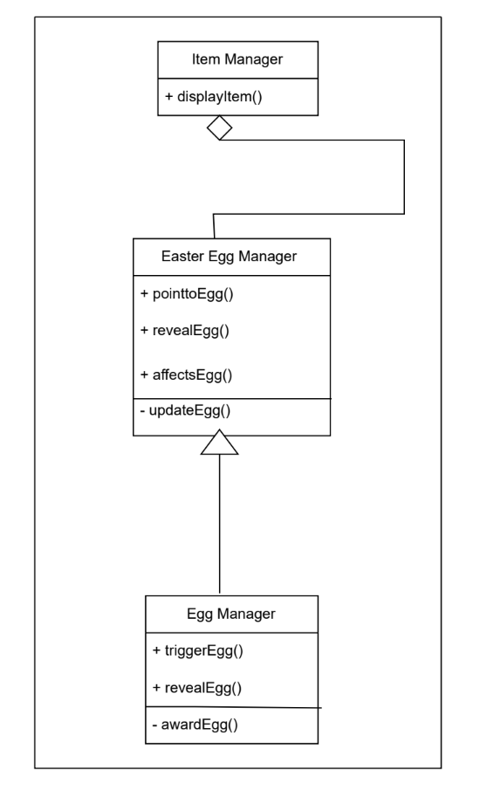
Easter Egg Class Diagram
Meghan

Slide 49
Any Questions?
Everyone

